Slide 1


Dream On: Dreamer V3 for Continual Reinforcement Learning via Permanent-Transient Critic Decoupling
Zihan Wang, Alex Koran, Thomas Lai
COMP 579 Final Project
Notes:
Hey everyone, our project is Dream On, which is Dreamer V3 for ……………………..

Slide 2
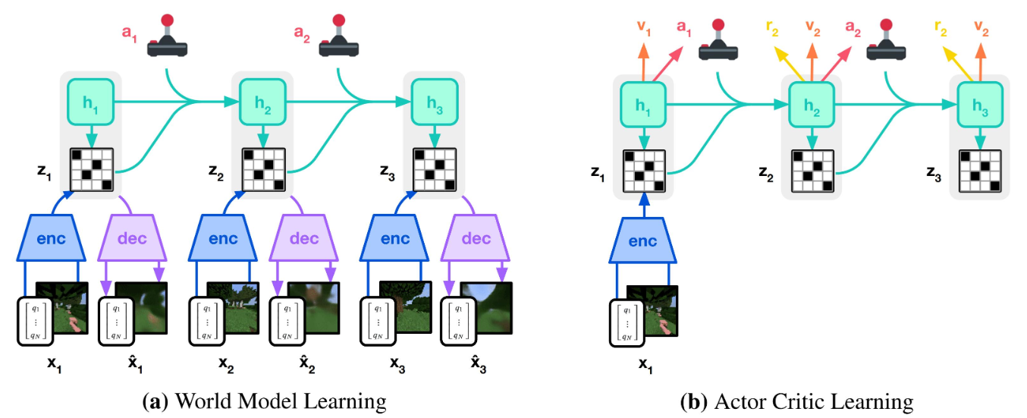
Original DreamerV3

Slide 3
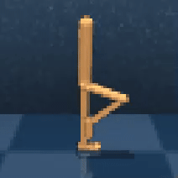
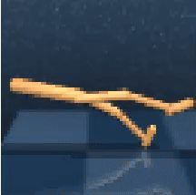
Continual Reinforcement Learning
Environments where the task changes (often by changing the reward function or state transition)
Goal is to retain prior knowledge while being able to adapt.
Walk
Stand
Notes:
One promising subfield of RL is Continual Reinforcement Learning (CRL). In this more recent domain, agents attempt to train sequentially on various similar tasks and environments, utilizing previously attained knowledge. This addresses the concept of lifelong learning in RL, allowing agents to generalize their actions and policies throughout a large range of different environments and tasks.

Slide 4




Our method: Continual Dreamer V3
Transient value function
Trained with the original DreamerV3 critic loss, but with the overall value function for the target.
Permanent value function
Trained by minimizing MSE with the overall value function.
Overall value function
*
and
are neural networks and
discretizes the state space.

Slide 5
Experiment Setting
Use random agent with random action to explore the world for 4000 steps when interact with new environment.
Task ‘stand’ and task ‘walk’ switching between them every 100,000 steps.
Original DreamerV3 stored the experience in experience buffer with size 1,000,000, and sample the experience as training data

Slide 6
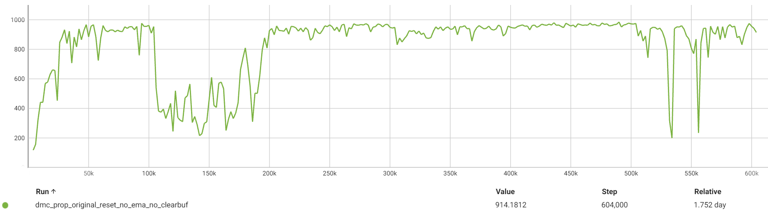
Performance of original DreamerV3
Dataset Size 1,000,000
Stand
Walk
Stand
Walk
Stand
Walk

Slide 7
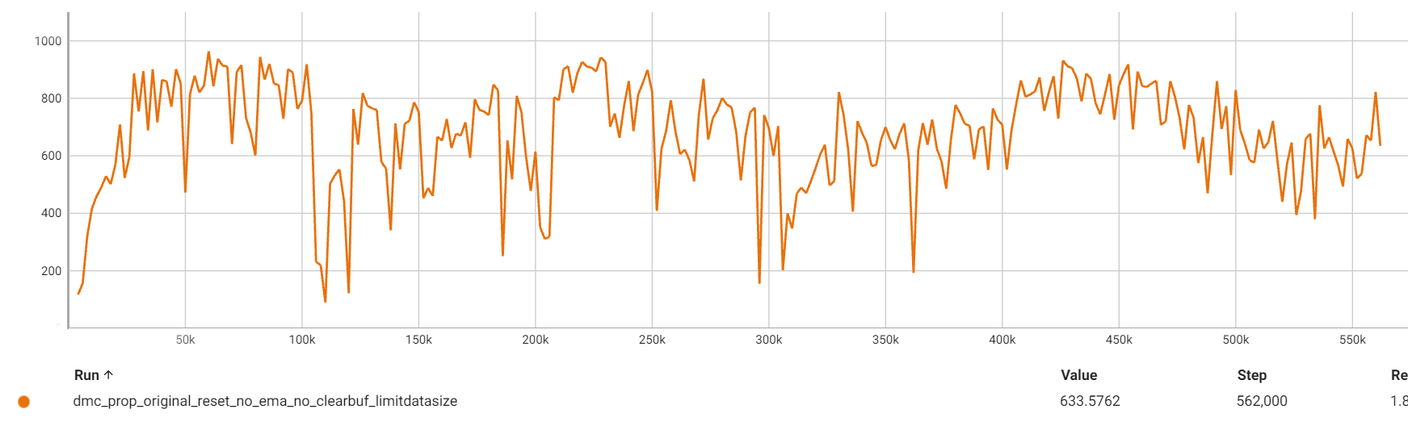
Performance of original DreamerV3 with dataset limitation
Dataset Size 4,000
Stand
Walk
Stand
Walk
Stand
Walk

Slide 8
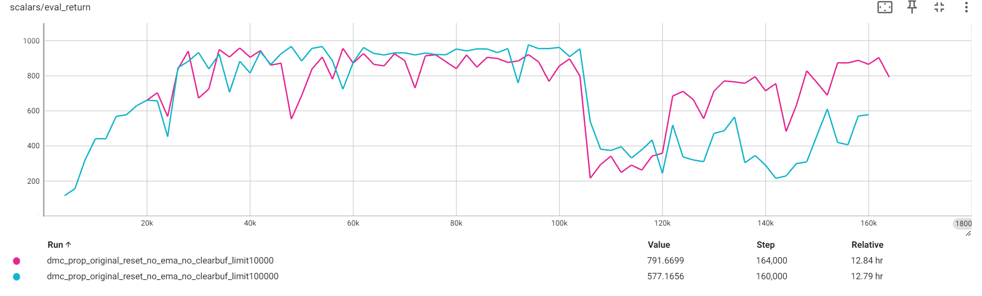
Performance of original DreamerV3 with dataset limitation

Slide 9
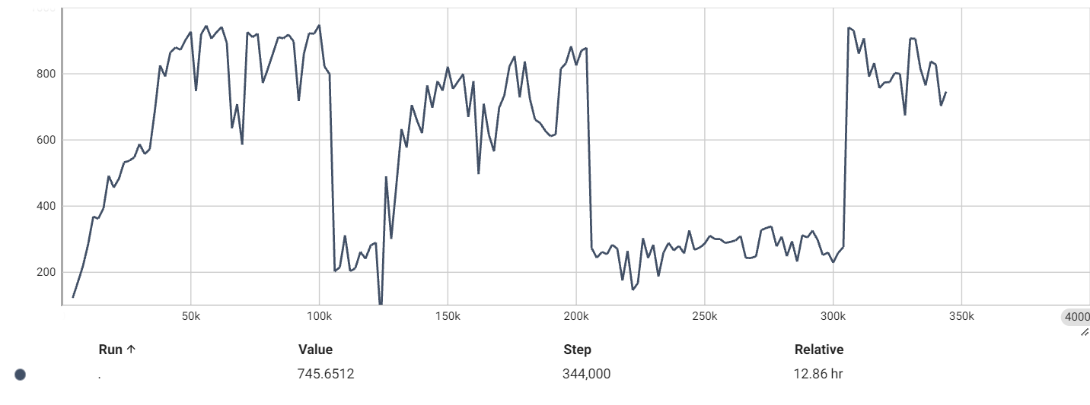
Performance of original DreamerV3 with dataset limitation
Dataset Size 10,000
Stand
Walk
Run
Stand

Slide 10
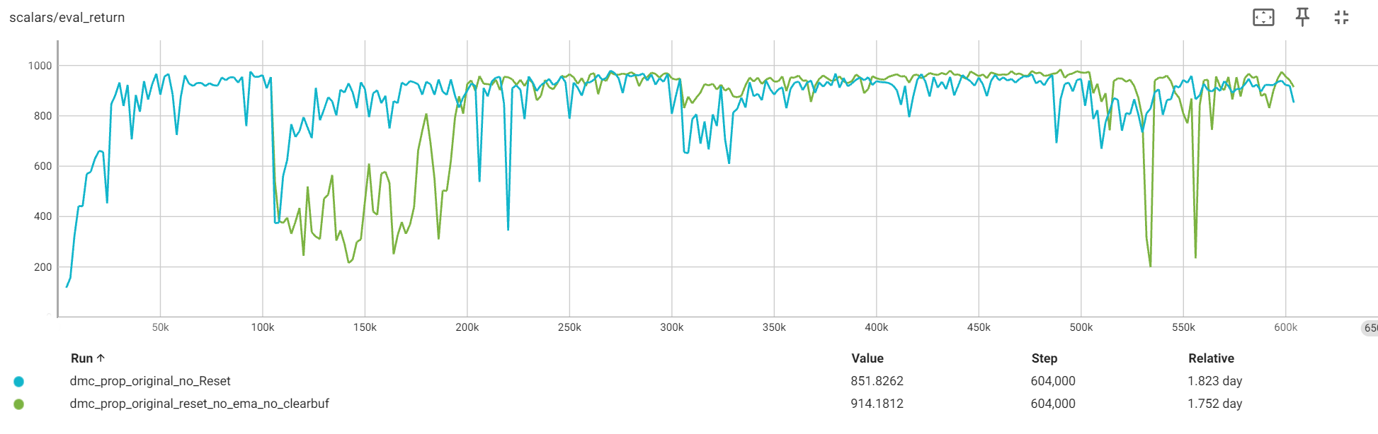
Clear Buffer Vs. No Clear Buffer
Dataset Size 1,000,000

Slide 11
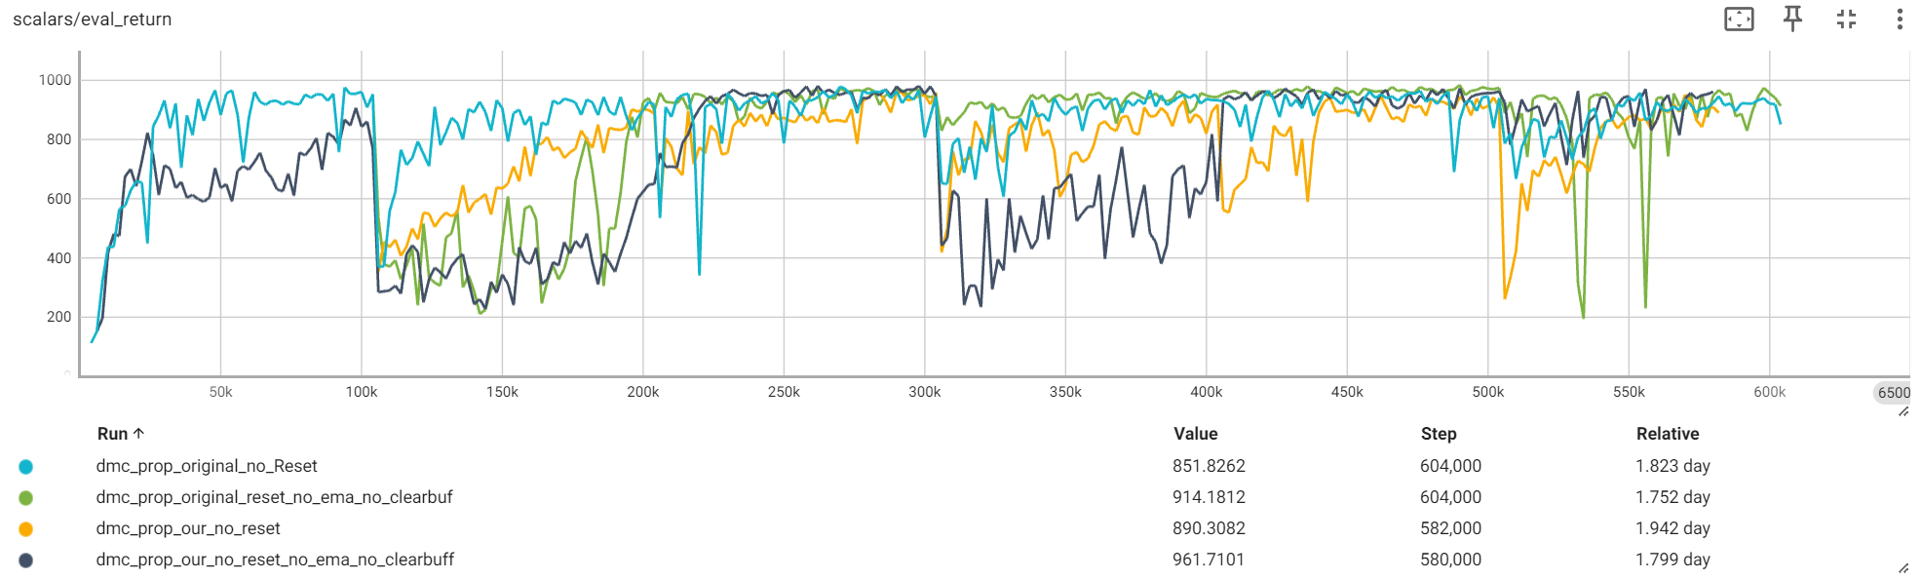
Clear Buffer Vs. No Clear Buffer

Slide 12
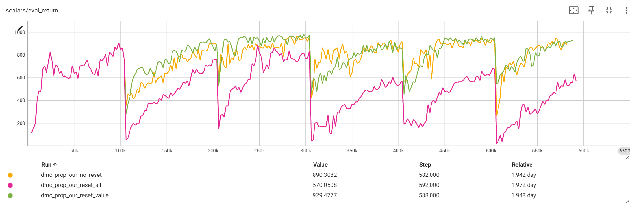
Clear the buffer and reset model

Slide 13
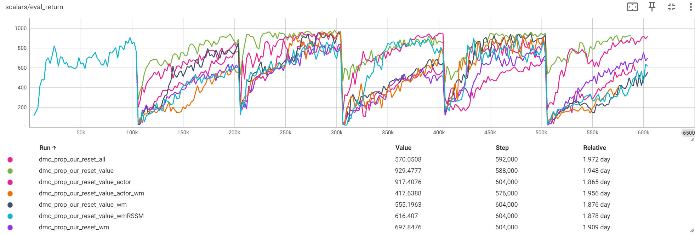
Clear the buffer and reset model

Slide 14
Naive Idea
Buffer Size changes hurt the performance
When task changes, do we need to use the random agent to do prefill steps
Do we need to clear the buffer when task changes?

Slide 15
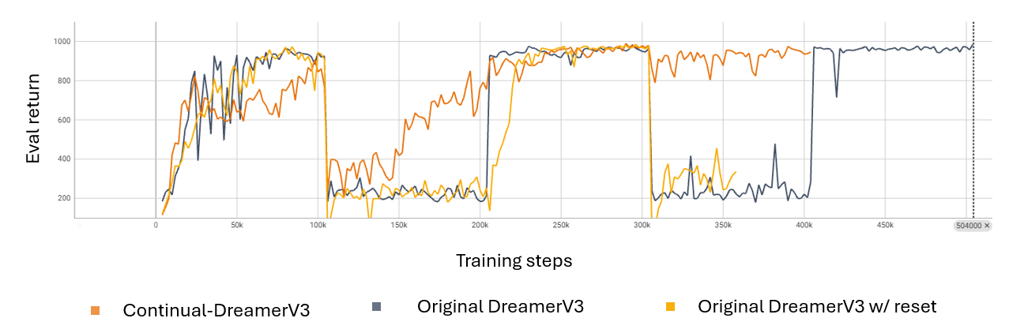
Previous Mistake we made, original dreamerV3 (Black) has no prefill so doesn't learn

Slide 16
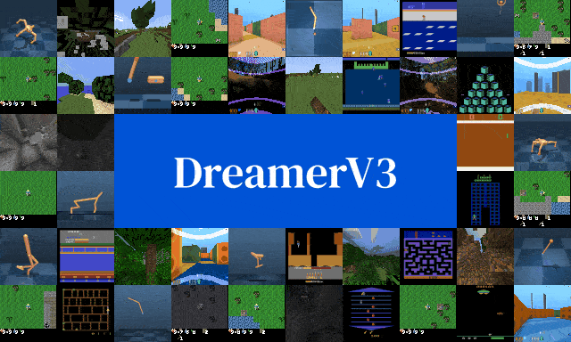

Dreamer V3
Value Function Decoupling
Hafner et al, 2023
Anand and Doina, 2023
Notes:
One model we looked at was Dreamer V3, which is a reinforcement learning algorithm which accomplishes multiple complex tasks in various environments without requiring domain specific tuning. It is based on several components, including actor and critic components, and a world model, which are concurrently trained on replayed experiences.
We also looked at the paper "Prediction and Control in Continual Reinforcement Learning", which offered a new potential solution to the Stability-Plasticity dilemma in reinforcement learning. The proposed solution suggests a two component system. The value function is broken into a transient component, which has a recency bias capturing current information into the policy, and a permanent component, which focuses on retaining past experiences and general knowledge.

Slide 17
Our method: Continual Dreamer V3
Transient value function
Trained with the original DreamerV3 critic loss, but with the overall value function for the target.
Permanent value function
Trained by minimizing MSE with the overall value function.
Overall value function
*
and
are neural networks and
discretizes the state space.

Slide 18
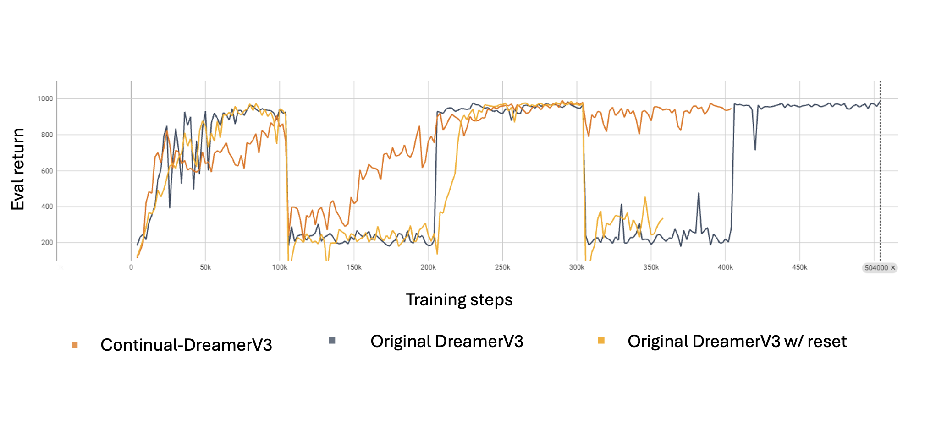
Experiments
Knowledge retention
Stand
Walk
Notes:
In our experiments, we compared Continual-DreamerV3 with the original DreamerV3 on the DeepMind Control Suite environment. We chose the "Walker Stand" and "Walker Walk" tasks, switching between them every 100,000 steps. To ensure a fair comparison, we reduced the parameters in our model's transient and permanent critics by half and used two separate Adam optimizers. We also experimented with re-initializing different parts of the model to see how it would affect performance.
During our tests, we evaluated the agents' performance every 2,000 steps to check their progress. We found that the original DreamerV3 had trouble learning new tasks after switching from one to another. Specifically, it struggled with the 'walk' task after performing the 'stand' task but retained its ability to 'stand'.
In contrast, Continual-DreamerV3 showed better adaptability. It could quickly learn the 'walk' task and maintain that knowledge after transitioning back to the 'stand' task. This highlighted the model's strength in continual learning situations.

Slide 19
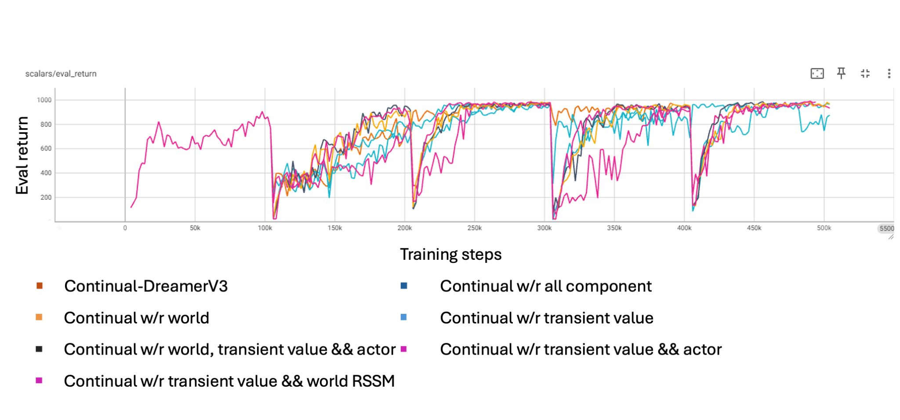
Experiments
Knowledge retention
Stand
Walk
Notes:
We also explored different re-initialization strategies, which involved resetting parts of the model, like the Recurrent State Space Model, the reward predictor, and the actor-critic networks. Our results showed that reinitializing the value function was particularly effective when switching tasks. It helped the model quickly regain its performance, suggesting it could retain essential knowledge even after re-initialization.
%% Interestingly, in some cases, not re-initializing led to better results, particularly in the 'walk' task. This finding points to how the tasks are structured and how models might adapt to them. Overall, our experiments show that Continual-DreamerV3 has a robust learning capacity and can adjust to continual learning challenges.

Slide 20
Experiments
continual DreamerV3 without re-initialization
Stand
Walk

Slide 21
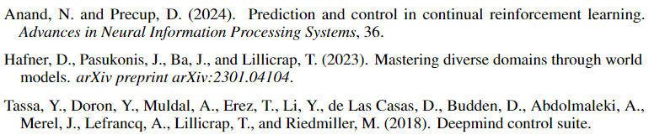
References

Slide 22
Does know boundary information important?
The experiment task is DMC Walker: walk and run
The task changes at 150K Steps
When we know task changes, what can we do?
Deploy random agent to explore the world first
Clear the buffer
Reset the model params and optimizer

Slide 23
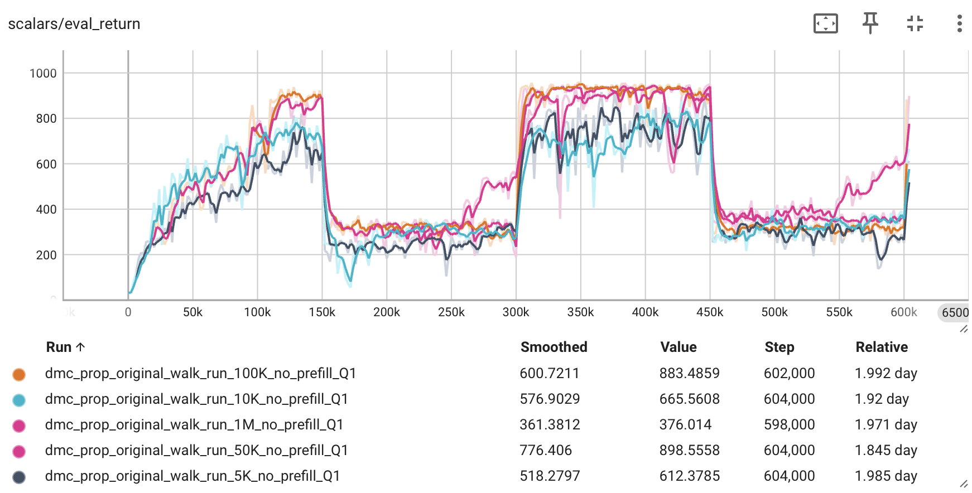
Original dreamerV3 with different buffer size

Slide 24
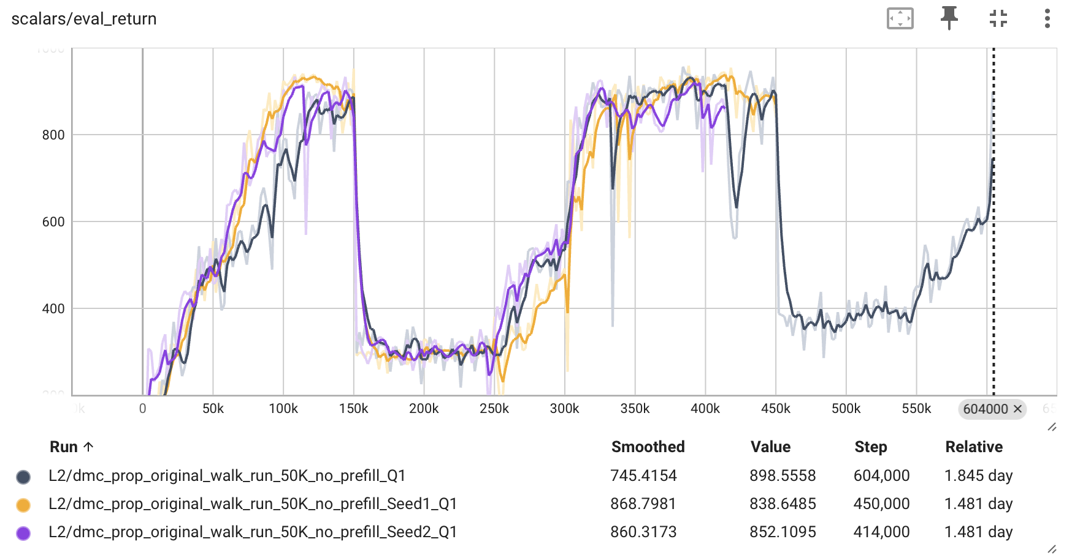
Variance of 50K buffer size setting

Slide 25
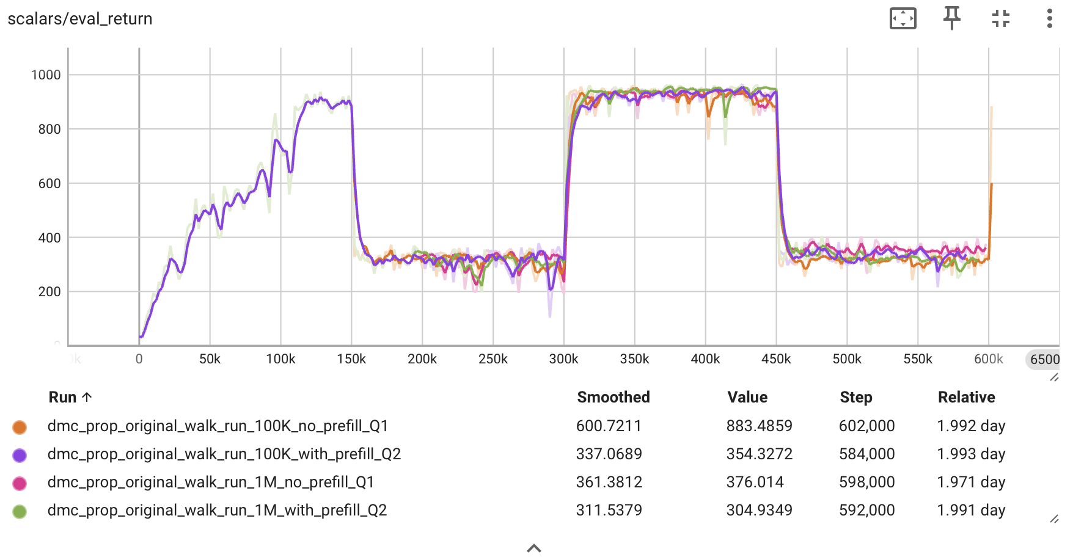
Discover does prefill helps – DreamerV3

Slide 26
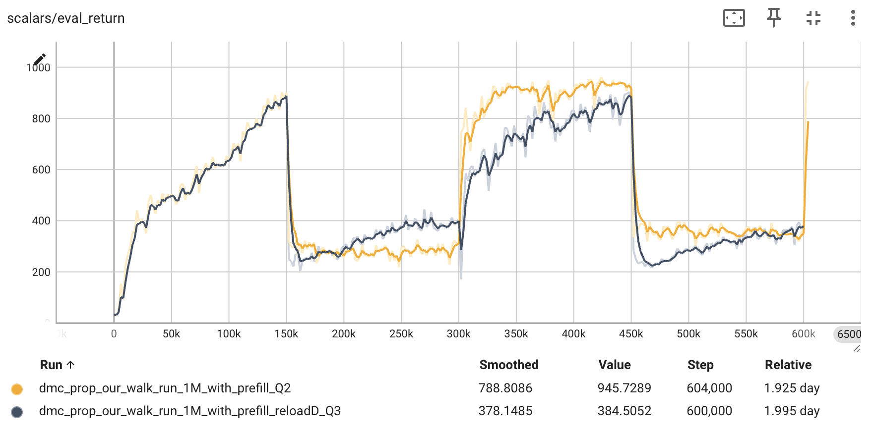
Does clear Buffer important? – Our

Slide 27
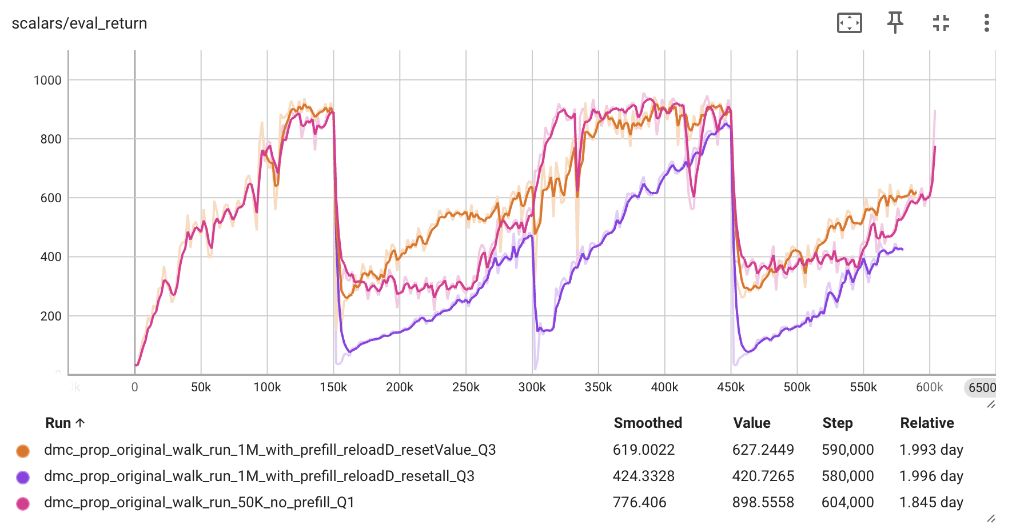
Does reset the model useful? – Original dreamerV3

Slide 28
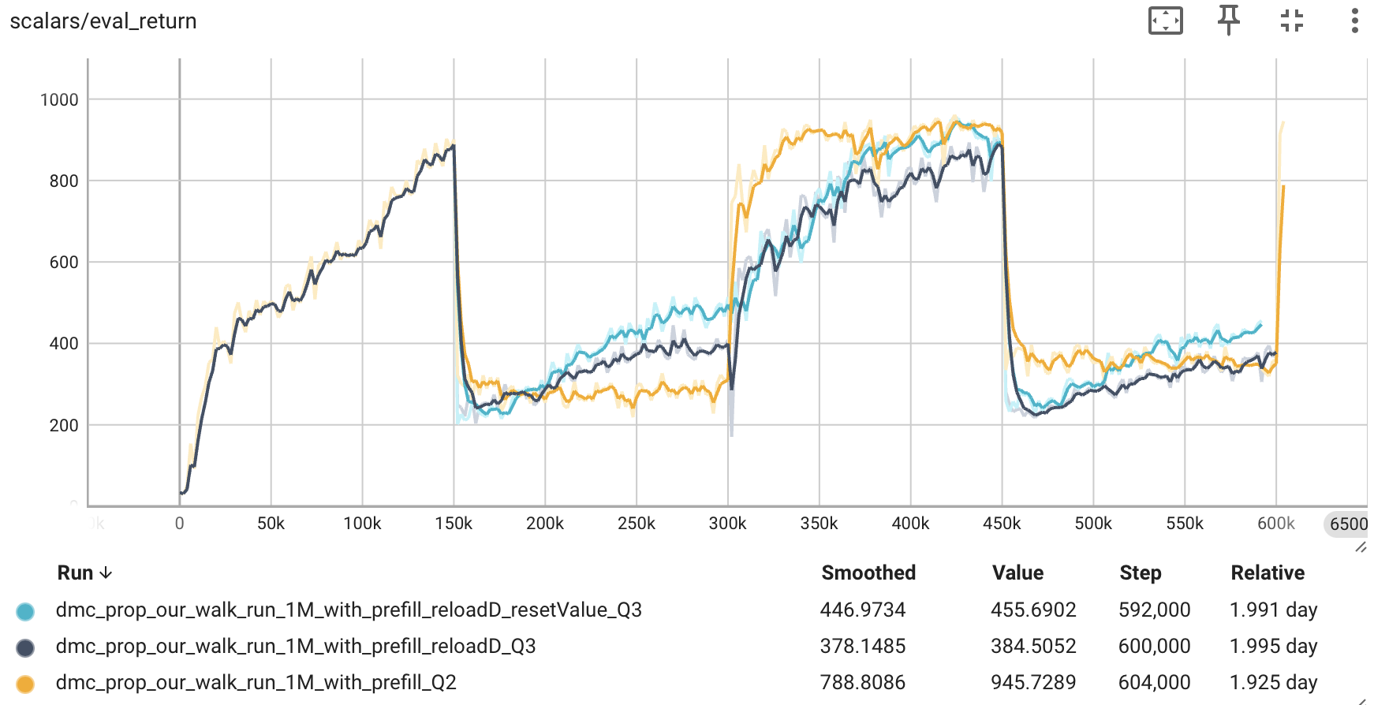
Does reset the model useful? – Our

Slide 29
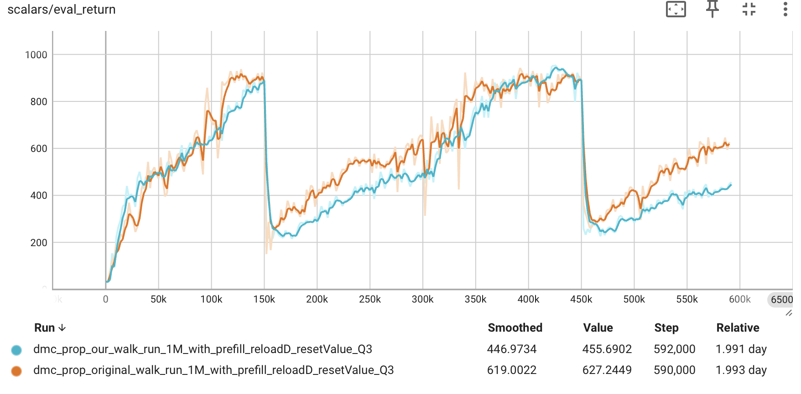
Compare our and original DreamerV3

Slide 30
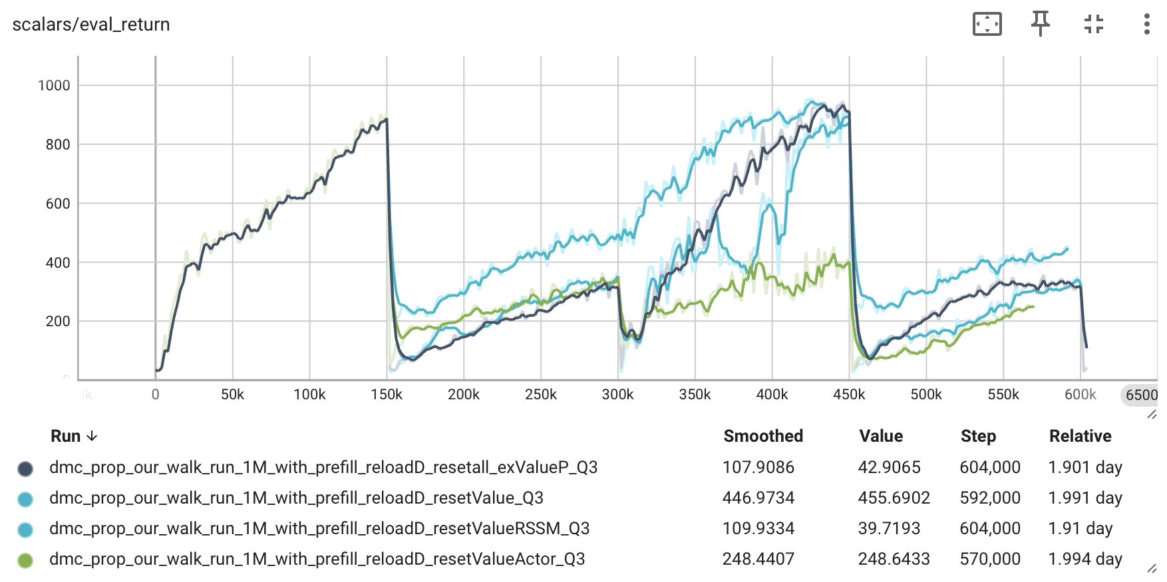
Which component should be reset?

Slide 31
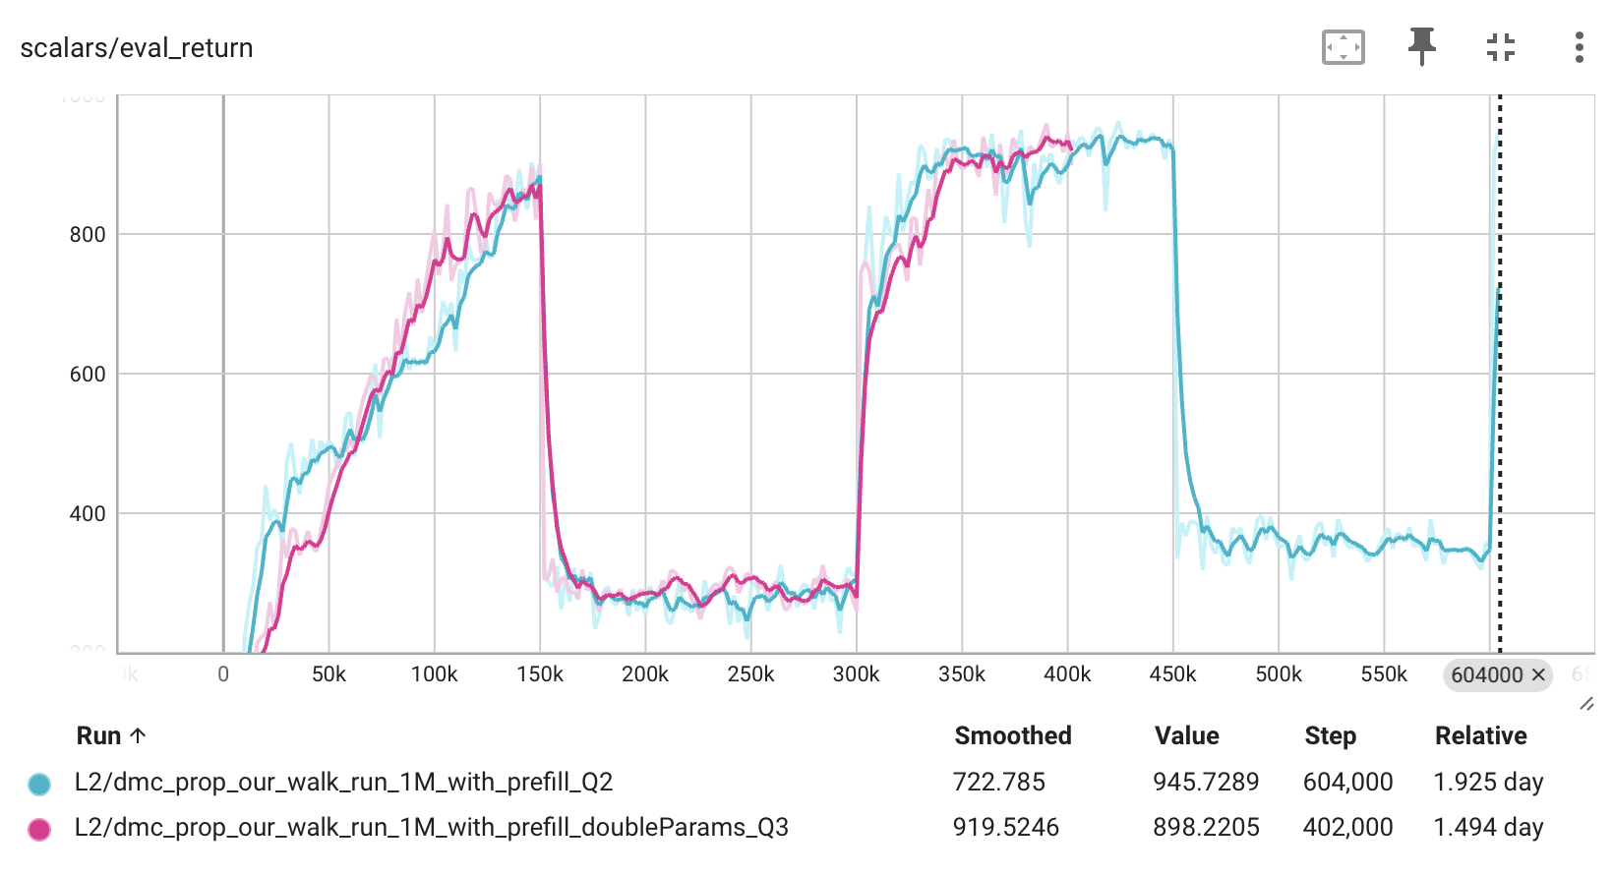
Our: Double the Value Model parameter

Slide 32
What about other experiments setting?
The experiment task is DMC Walker: stand and walk
The task changes at 100K Steps

Slide 33
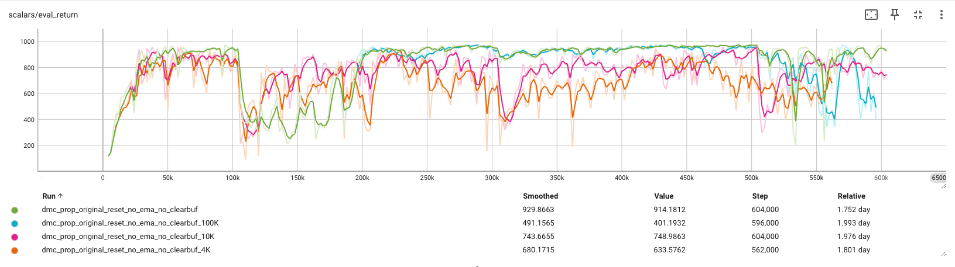
Original dreamerV3 with different buffer size with Prefill

Slide 34
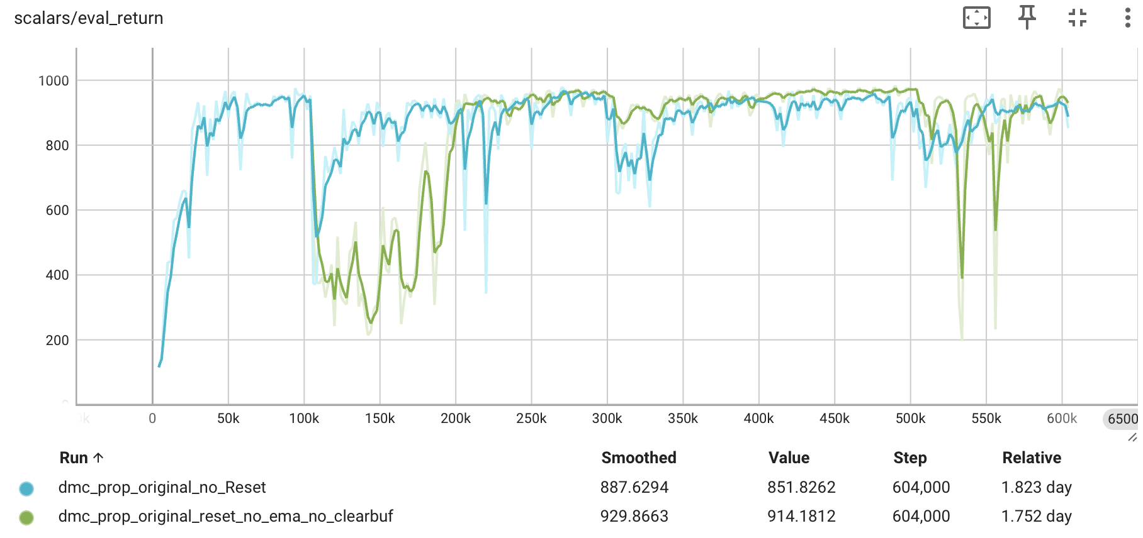
Does clear Buffer important? – DreamerV3

Slide 35
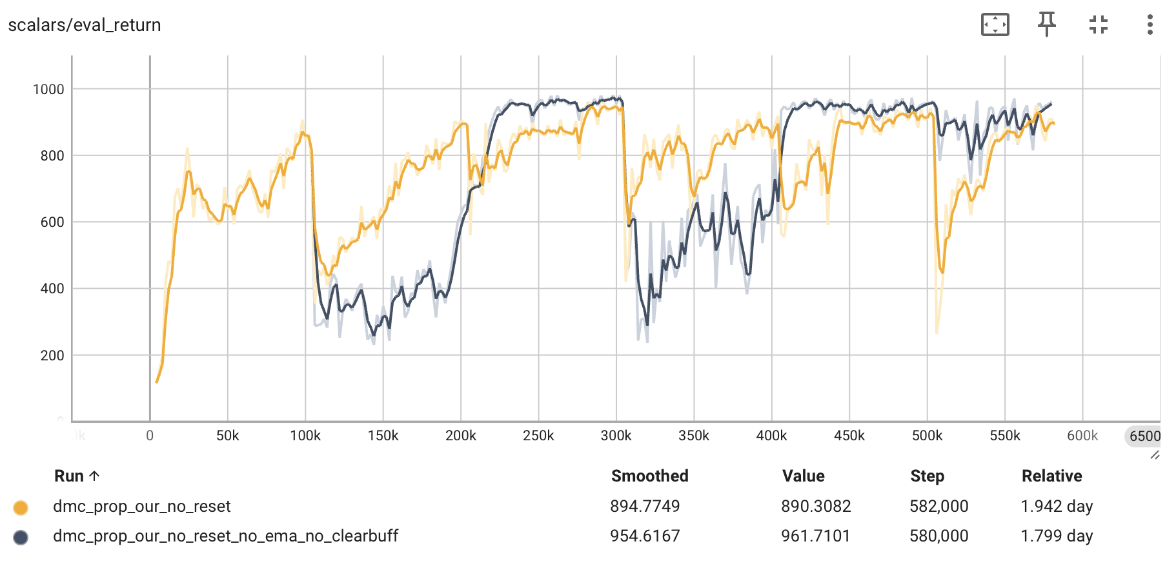
Does clear Buffer important? – Our

Slide 36
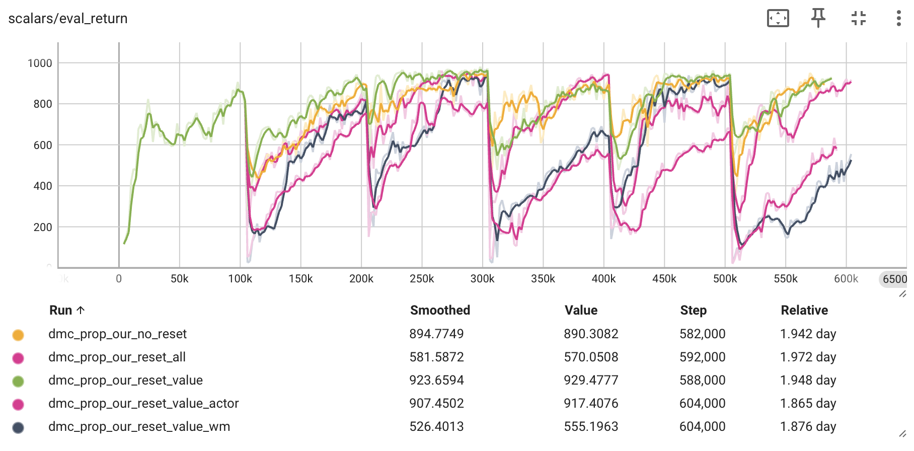
Reset Value function still important

Slide 37
For 3 tasks?
The experiment task is DMC Walker: walk, run, stand
The task changes at 150K Steps

Slide 38
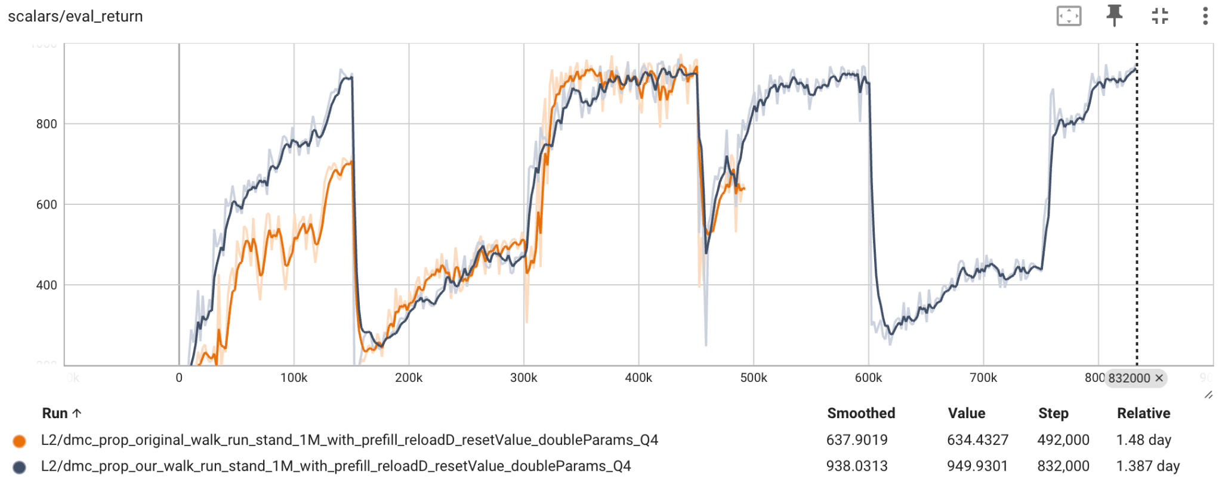
3 tasks, walk, run and stand

Slide 39
Other different environments

Slide 40
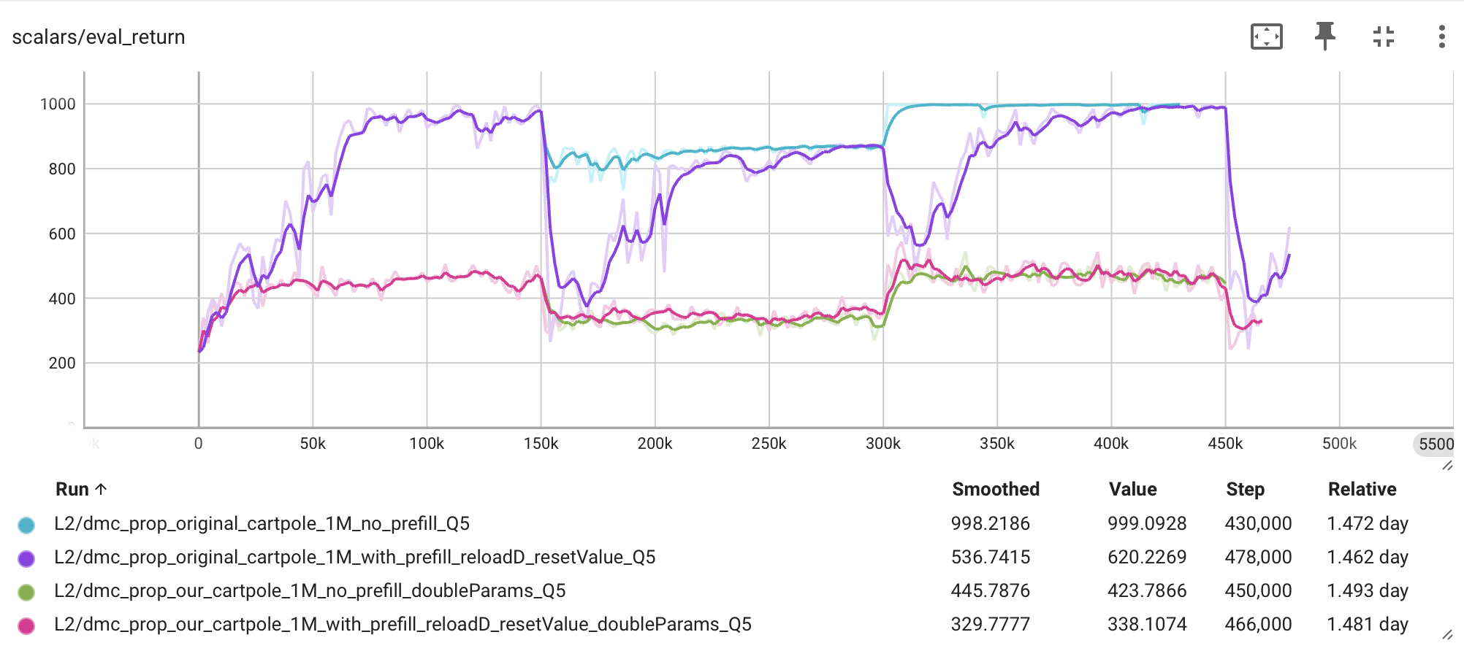
Cartpole, balance and swingup

Slide 41
Discussion
Task boundary: Reset Value function is important; Prefill is not important; Reload data kind likely important (maybe)
To detect task boundary: track the reward by using sliding windows? Track the reward loss in world model?
Any other component to allow model adapt the environment much quicker?
Permanent Value model updated times changes, because SGD is not as fast as Adam

